Slide 1
Video Based surveillance system and path prediction
PROJECT GUIDE-MS.V.SATHIYA
DOMAIN-ARTIFICIAL INTELLIGENCE
S.OMEZHILE (2017PECCS185)
P.POOJA (2017PECCS193)

Slide 2
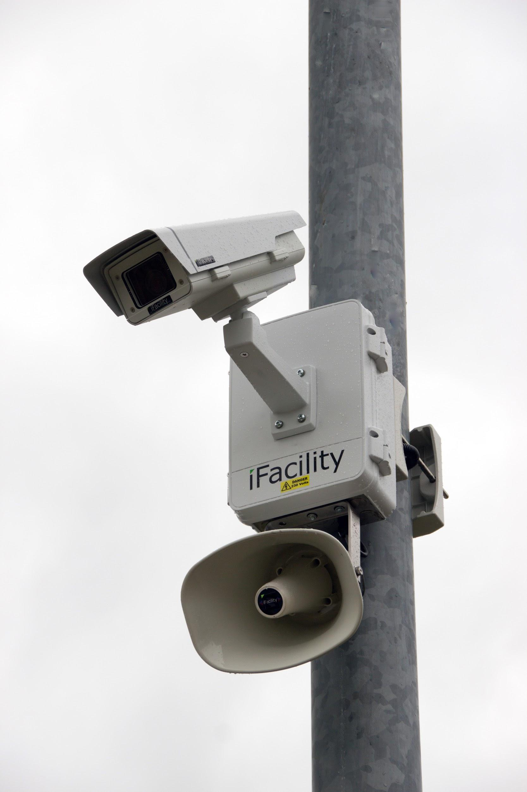
INTRODUCTION
As an important branch of Security and surveillance system,face recognition technology has the characteristics of convenient acquisition and high reliability that is widely used in the fields of information security, national security, traffic monitoring,security camera and organisations like school, college. This project is to Detect Unknown or specified given person(criminal) in Surveillance camera at Traffic signals and predicting his probability path further then reporting to their nearby located control rooms .

Slide 3
LITERATURE REVIEW
Year Of Publishing | Author Name | Title Of The Paper | Merits | Demerits
2020 | Shuai Tang, Mani Golparvar, Milind Naphade | Vedio Based Motion & Monitoring Systems | Reduce loss, theft and vandalism. | It can be costly affair
Link Of:https://scholar.google.co.in/scholar?q=video+based+surveillance+System+and+Path+Prediction+journal+2020&hl=en&as_sdt=0&as_vis=1&oi=scholart#d=gs_qabs&u=%23p%3D6QKLnLTfm-EJ

Slide 4
Year Of Publishing | Author Name | Title Of The Paper | Merits | Demerits
2019 | G.Sreenu & M.A.Saleem Durai | Intelligent Video Surveillance | The method can identify abnormal behaviour in both individual and groups | Continous monitoring of video is difficult and tiresome for humans.
Link Of Paper : https://journalofbigdata.springeropen.com/articles/10.1186/s40537-019-0212-5

Slide 5
Year Of Publishing | Author Name | Title Of The Paper | Merits | Demerits
2018 | Yu Kong, Yun Fu | Human Action Recognition And Prediction | Improve productivity. | They are vulnerable
Link Of Paper : https://scholar.google.co.in/scholar?q=video+based+surveillance+System+and+Path+Prediction+journal+2018&hl=en&as_sdt=0&as_vis=1&oi=scholart#d=gs_qabs&u=%23p%3DsCCYhYxmkZUJ

Slide 6
Year Of Publishing | Author Name | Title Of The Paper | Merits | Demerits
2018 | Dimitrios Makris, Tim Ellis | Path Prediction In Video Surveillance | Makes the public feel safer & more at ease | Doesn’t stop a crime that is in action.
Link Of Paper: https://scholar.google.co.in/scholar?q=video+based+surveillance+system+and+path+prediction+journal&hl=en&as_sdt=0&as_vis=1&oi=scholart#d=gs_qabs&u=%23p%3DRIfkIiSDW00J

Slide 7
Year Of Publishing | Author Name | Title Of The Paper | Merits | Demerits
2017 | Graeme A.Jones, Nikos Paragios. | Video Based Surveillance System | Cops can view video in real-time from smart devices. | Privacy is an important issue.
Link Of Paper:https://www.researchgate.net/publication/42242342_Video-Based_Surveillance_Systems_Computer_Vision_and_Distributed_Processing

Slide 8
TECHNOLOGY STACK:
HARDWARE:
SURVEILLANCE CAMERA-To capture and detect the specified person
MONITORING SCREEN-To monitor the movement of capturing video
SOFTWARE:
Opencv to train images
Window 10-operating system
Python language
API to send messages
Algorithm-CNN
Telegram

Slide 9





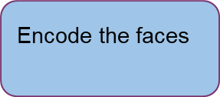

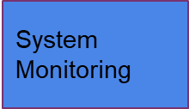

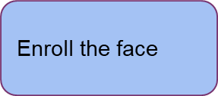

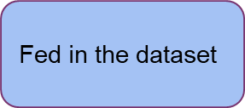
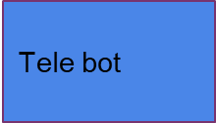
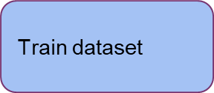

SYSTEM ARCHITECTURE

Slide 10
SYSTEM DESIGN
UML DIAGRAM
Get face to train and train the images
Examine the monitor
Train to detect
Gets notification in telegram
Train to predict way
Developer
Scan and search for thief by trained images
Sends force to capture in that specific location
user
If finds sends video in telegram
Detector

Slide 11
DB DESIGN
Motion and Object Detection
Network Switch
Object Classification
Data Fusion
Video Processing
Transmission and Storage
Database
Object Tracking
Behavioural and activity analysis

Slide 12
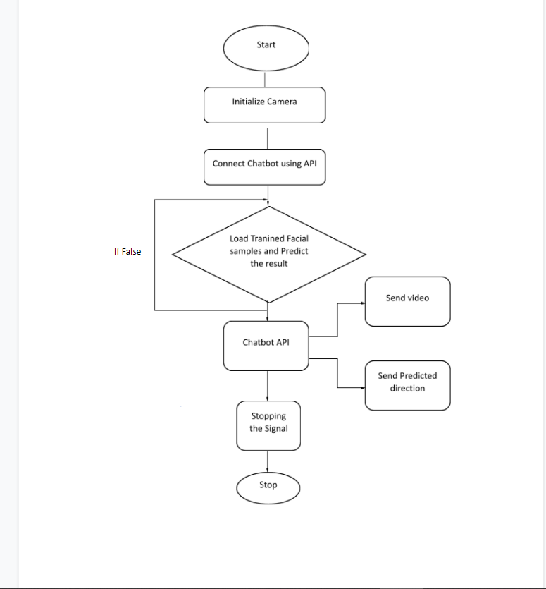
Flow Diagram:

Slide 13
TESTING
PROGRAM TESTING :
The logical and syntax errors have been pointed out by program testing.
A syntax error is an error in a program statement that in violates one or more rules of the language in which it is written.
An improperly defined field dimension or omitted keywords are common syntax error.
These errors are shown through error messages generated by the computer.

Slide 14
SECURITY TESTING :
Security testing attempts to verify the protection mechanisms built in to a system well, in fact, protect it from improper penetration.
The system security must be tested for invulnerability from frontal attack must also be tested for invulnerability from rear attack
During security, the tester places the role of individual who desires to penetrate system.

Slide 15
VALIDATION TESTING :
At the culmination of integration testing, software is completely assembled as a package.
Interfacing errors have been uncovered and corrected and a final series of software test-validation testing begins.
Validation testing can be defined in many ways, but a simple definition is that validation succeeds when the software functions in manner that is reasonably expected by the administrator.

Slide 16
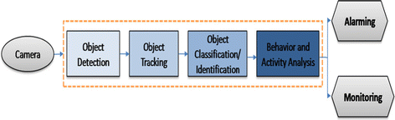
PERFORMANCE ANALYSIS:

Slide 17
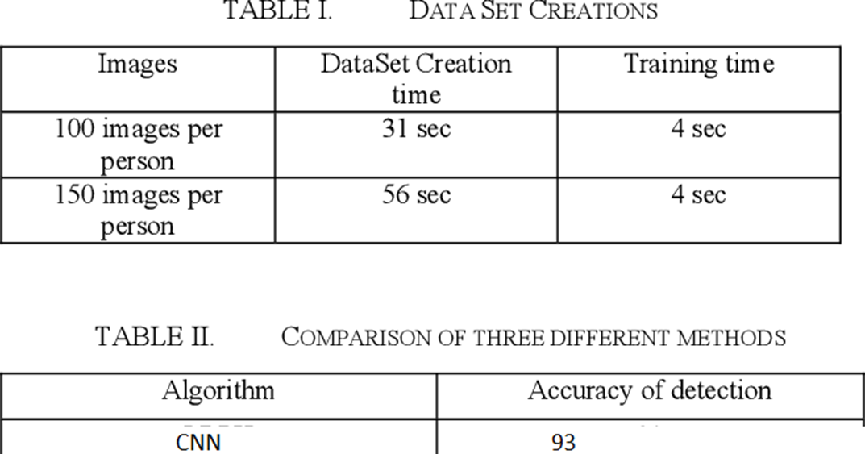

Slide 18
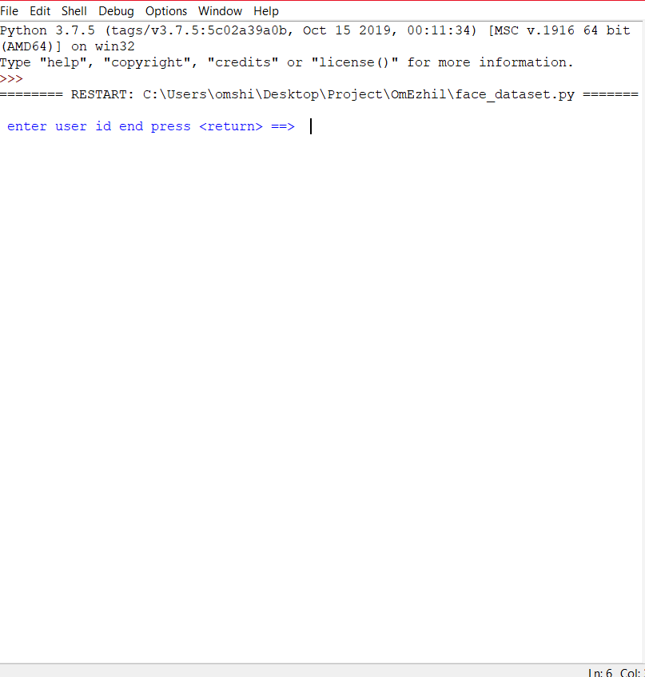
SCREENSHOTS
1.Initializing the program to add dataset

Slide 19
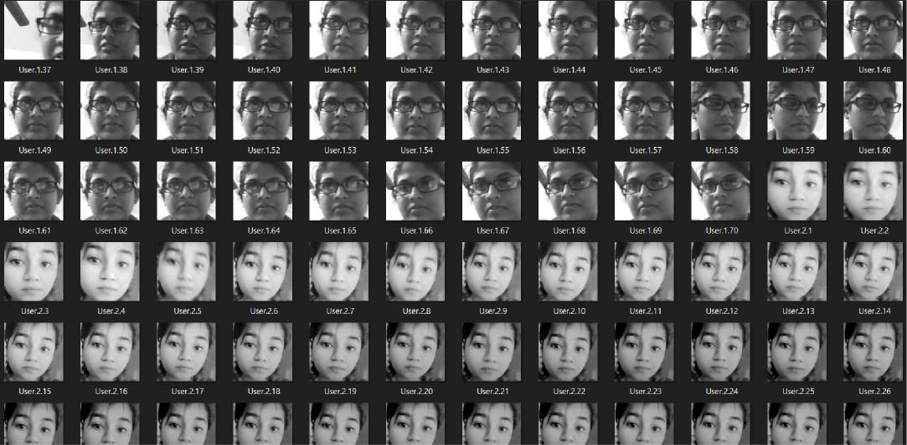
2.storing the dataset

Slide 20
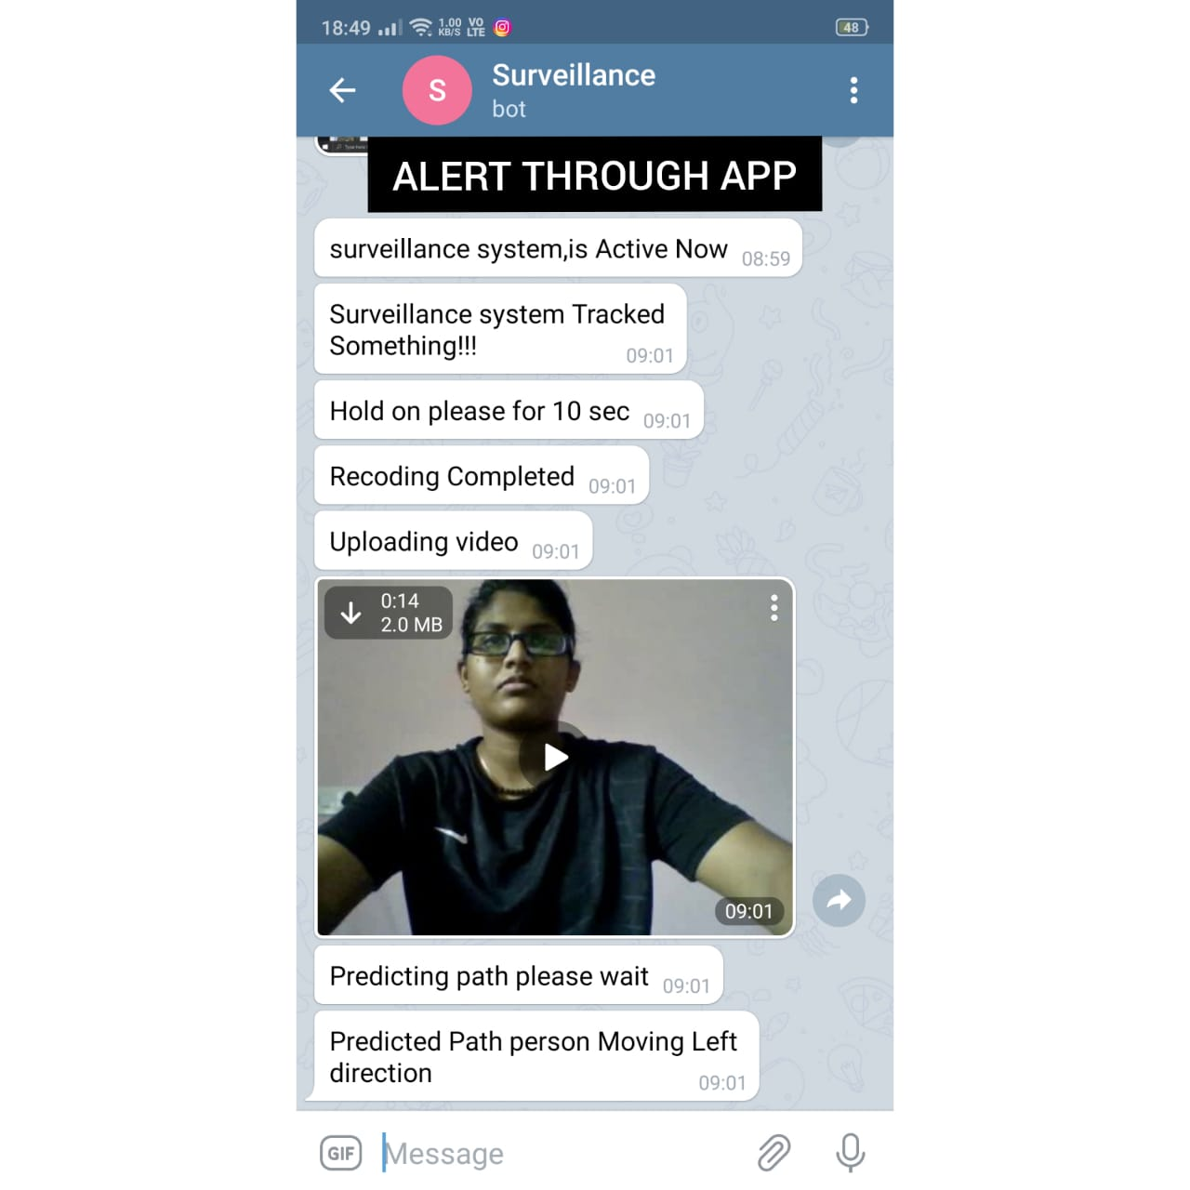
3.If found,it will send the alert through telegram

Slide 21
CONCLUSION
This project is used to implement the face recognition and surveillance.
Face recognition nowadays has been widely used on many areas, can be improved with the implement of this product.
It is design with low cost and efficient material.
The improvement of technology had made the internet of thing no longer an expensive stuff and it can be modified and customized depend on our needs.

Slide 22
REFRENCE
Erdem, H., Uner and A. (2009) ‘A multi-channel remote controller for home and office appliances’, IEEE Xplore Digital Library, vol. 55, no. 4, pp. 2184-2189.
Yuksekkaya, B., Kayalar, A.A., Tosun, M.B., Ozcan, M.K., Alkar and A.Z., (2006) ‘A GSM, internet and speech controlled wireless interactive home automation system’, IEEE Xplore Digital Library, vol. 52, no. 3, pp. 837-843.
Vernon, S., Joshi and S.S., (2011) ‘Brain—Muscle—Computer Interface: MobilePhone Prototype Development and Testing’, IEEE Xplore Digital Library, vol. 15, no. 4, pp. 531-538.
Faundez-Zanuy and M. (2005) ‘Privacy issues on biometric systems’ , IEEE Xplore Digital Library, vol. 20, no. 2, pp. 13-15.

Slide 23
P. B. Saurabh and D.S. Chaudhari (2012) ‘Principal Component Analysis for Face Recognition’, International Journal of Engineering and Advanced Technology, , IEEE Xplore Digital Library, vol. 1, pp. 91-94.
Sahani, M., Nanda, C., Sahu, A.K.,Pattnaik, B. (2015) 'Web-based online embedded door access control and home security system based on face recognition', IEEE Xplore Digital Library[online], 19-20 March 2015, pp.1-6. Available from: http://ieeexplore.ieee.org.libezp.utar.edu.my/xpls/icp.jsp?arnumber=7159473&tag =1[Accessed 1 August 2017]
Thabet, A. and Amor, N. (2015) ‘Enhanced smart doorbell system based on face recognition’, IEEE Xplore Digital Library[online], 21-23 Dec. 2015, pp.373-377. Available from: http://ieeexplore.ieee.org.libezp.utar.edu.my/document/7505106/[Accessed 1 August 2017]
Neelam Majgaonkar, Ruhina Hodekar & Priyanka Bandagale (2016) Automatic Door Locking System Vol.4 Issue-1, 2016 p.495 – 499.

